Slide 1
Sensory Language
Word Bank

Slide 2
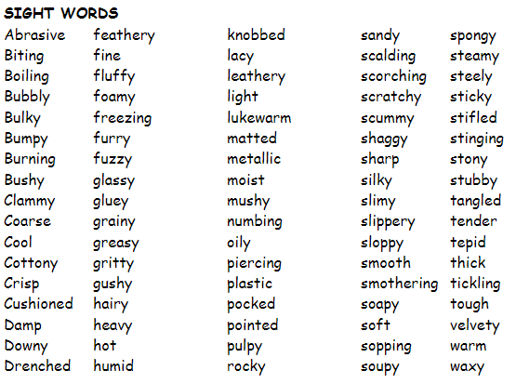

Slide 3
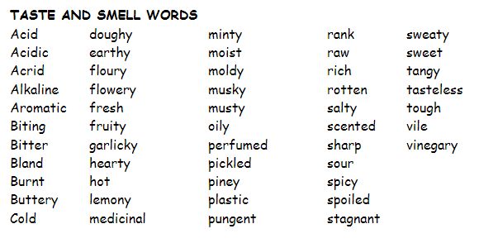

Slide 4
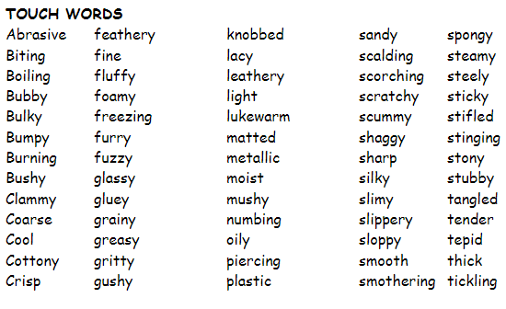

Slide 5
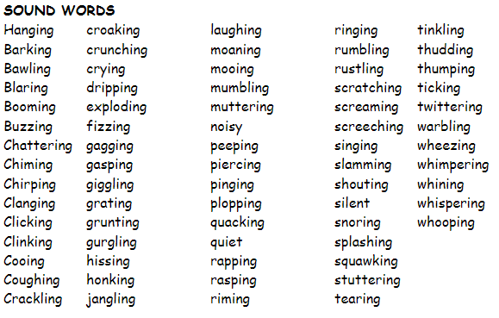

Slide 6
Click Here
For EVEN More Sensory Language Words

